Slide 1
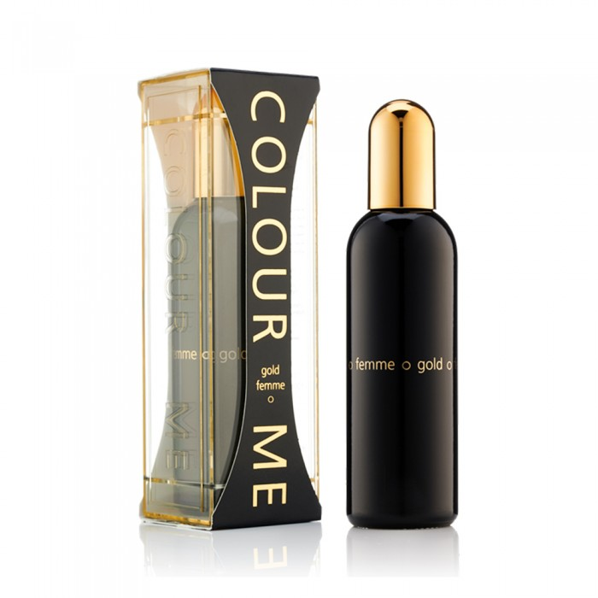
Claire Mae
Claire Mi Gold Women's Perfume 100ml
70.00 SAR. Q
Claire Mi Gold is an elegant, rich and wonderful fragrance. It is elegant for women and offers high, refreshing beads on a rich heart to enlighten all your senses. This women's fragrance is elegant, smooth and sensual for an absolute feminine sensation.

Slide 2
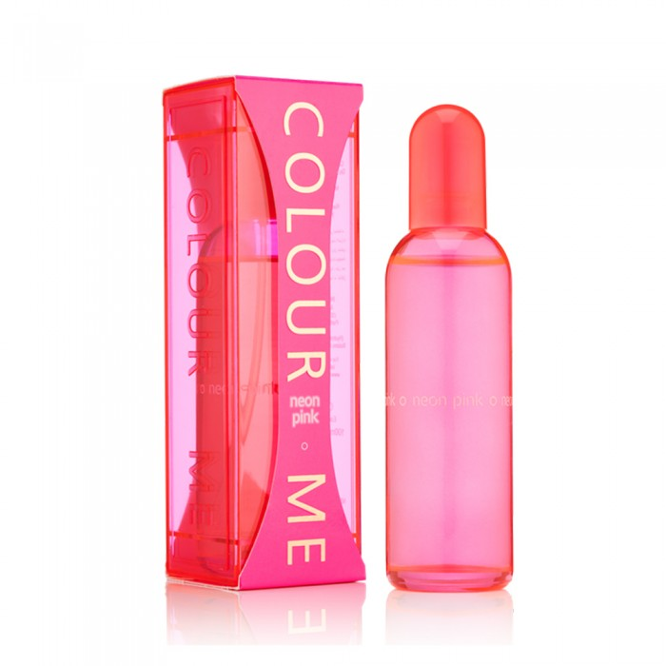
Claire Mae
Claire Mi Neon Pink Women's Perfume 100ml
70.00 SAR. Q
Claire Mi Neon Pink perfume makes you glittering, nice and fun. This vibrant fragrance for women determines the summer vibe with green mandarin, ginger and water jasmine. Color Me Neon Pink is bright and vibrant, making it the perfect fragrance for women looking to add confidence to their style.

Slide 3
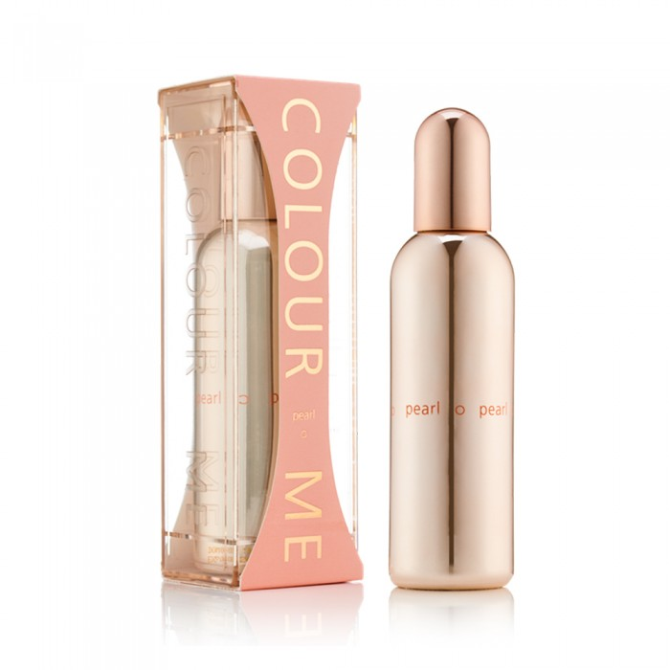
Claire Mae
Claire Mi Pearl Women's Perfume 100ml
70.00 SAR. Q
Clare Me Pearl is stylish, warm and distinctive. Add a little luxury to your life with Color Me Pearl, a gentle and delicate female perfume. The delicate mix of orange, yasmin and patchouli creates a refined fragrance for women that radiates elegance and magic.

Slide 4
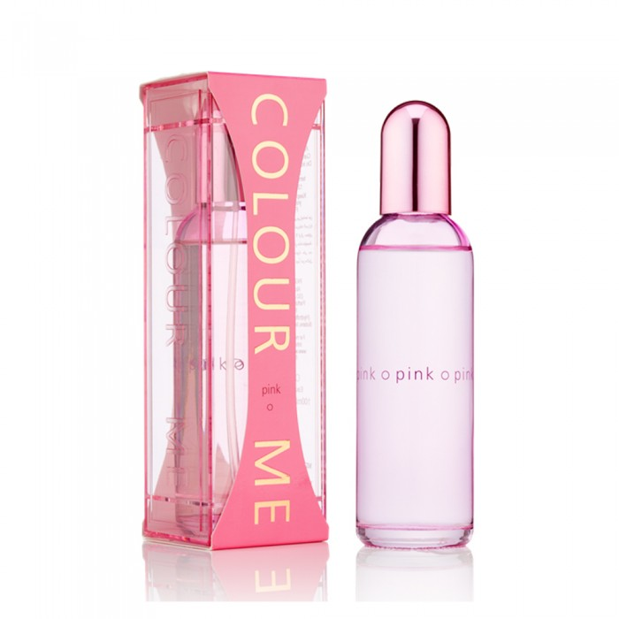
Claire Mae
Cler Mi Pink Women's Perfume 100ml
70.00 SAR. Q
Claire Mi Pink is a floral, warm, romantic and sophisticated female perfume. Claire Mi Pink delights through the fragrance mix made of distinctive oriental flowers and roses on a base of vanilla. This romantic, warm and sensual fragrance is the perfect fragrance for a woman.

Slide 5
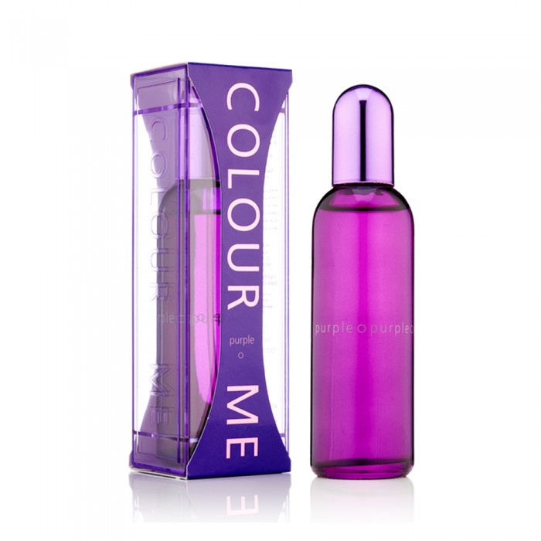
Claire Mae
Claire Mi Purple Women's Perfume 100ml
70.00 SAR. Q
Claire M. Purple is pure and fruity. This luxurious fruity fragrance combines elegance and beauty. Claire Mi Purple is rich with modern ingredients to create a classic fragrance for women. A thin floral agreement was carefully woven between layers of bergamot, watermelon, oak moss and amber.

Slide 6
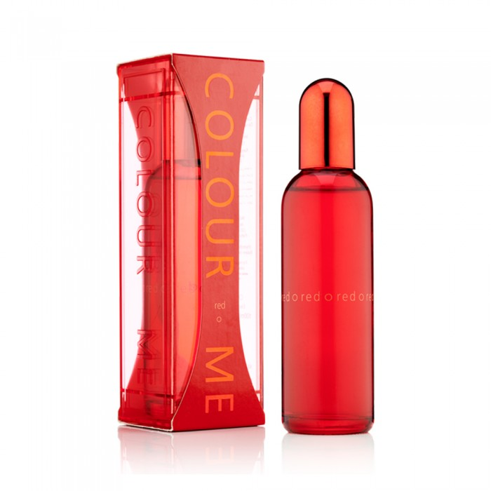
Claire Mae
Cler Mi Red Fragrance Women 100ml
70.00 SAR. Q
Clare Mi Red is a rich, elegant and distinctive female fragrance. An attractive female fragrance. Color Me Red is a luxurious fragrance that combines red fruits, cloves and the gospel of India for a special experience that makes you feel bright.

Slide 7
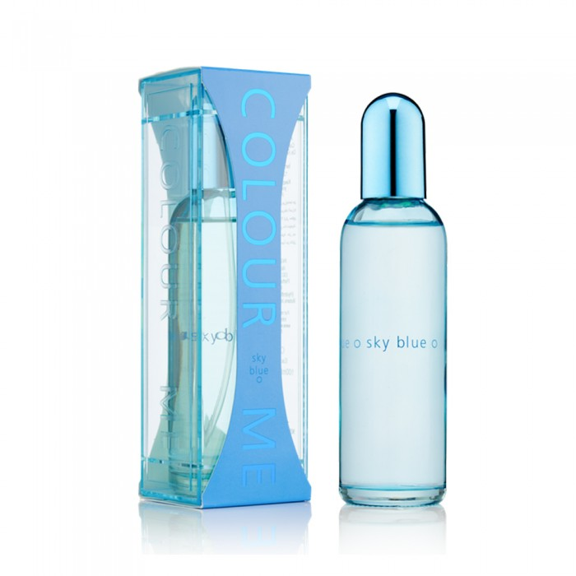
Claire Mae
Claire Mi Sky Blue Women's Perfume 100ml
70.00 SAR. Q
Claire Mi Sky Blue has a feminine and floral smell. ✿ get that summer vibe all year long with Color Me Sky Blue. It has the aroma of citrus from lemon extracts, cherries, peaches, jasmine, lily and musk making it very refreshing. It has a very light but long-lasting effect, as its effect lasts for 6 continuous hours without being put back on. It's specially made to make your day more vibrant and life-enriching with the charming smell of cattle.

Slide 8
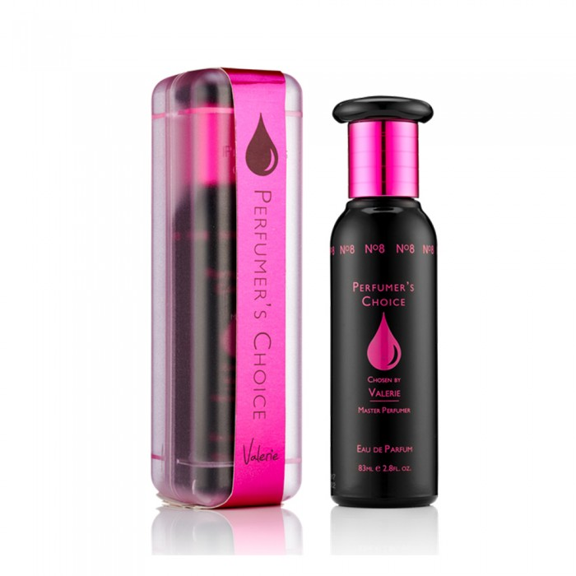
Perfumers Choice
Perfumers Choice Valerie Women's Fragrance 83 ml
87.00 SAR. Q
Perfumers Chois Valerie is a women's fragrance containing a bold mix of blackcurrants, oranges and coffee. This women's fragrance is an instant pleasure and is mixed with a sense of grace and sophistication. Valerie's long-standing fragrance for women, where the aromatic scent is characterized by a light fruity glimpse that makes it look great even after long hours of use. This product is a great choice for you if you are looking for a high quality perfume that is highly effective.

